Slide 1

Aspect

Slide 2
A new perspective to spot
potential corporate vulnerabilities
Aspect

Slide 3
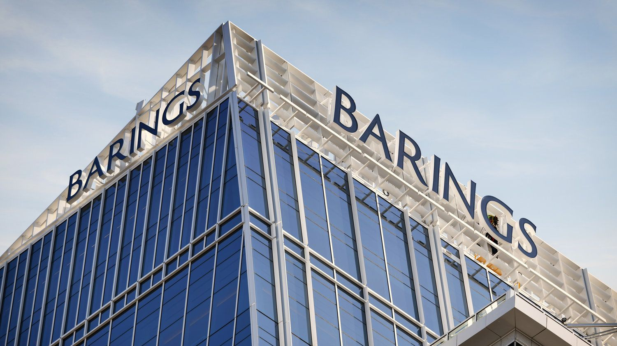

Lessons from Barings Bank

Slide 4



Problem Statement
1. Fragmented and inconsistent risk assessment methods
2. Non-public and non-transparent results
3. Inconvenient re-assessment and untimely detected risk

Slide 5
Our Solution
AI-driven risk analysis and insights
Public corporate information dashboard
Aspect
Warning for potential vulnerabilities

Slide 6
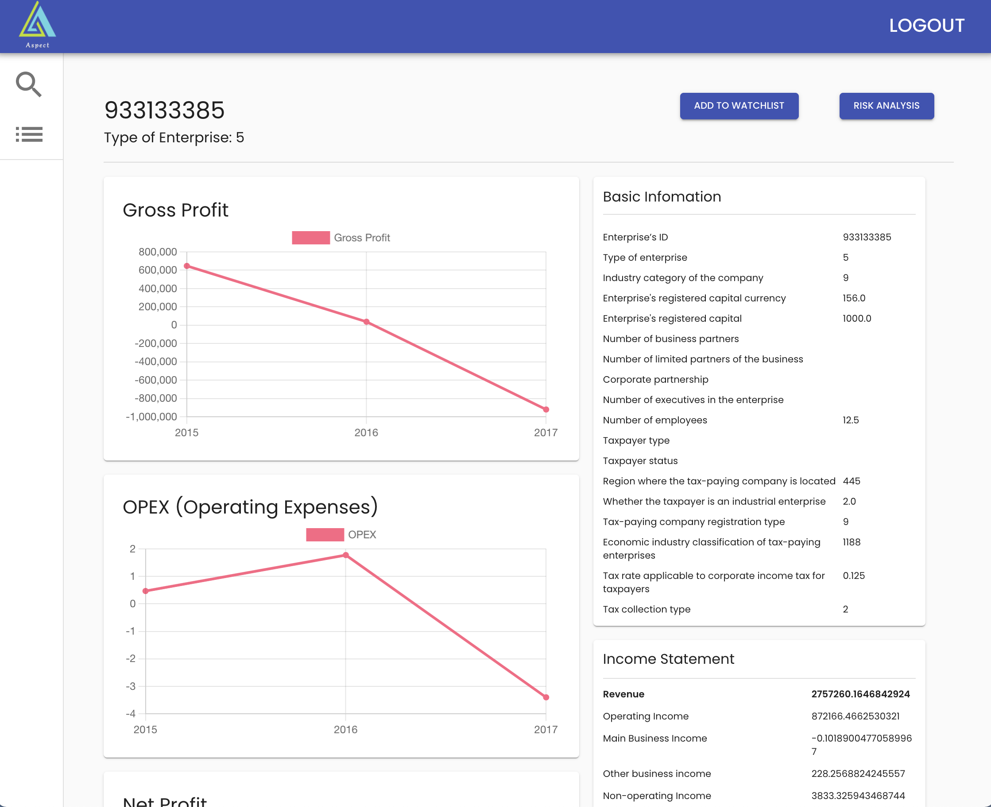
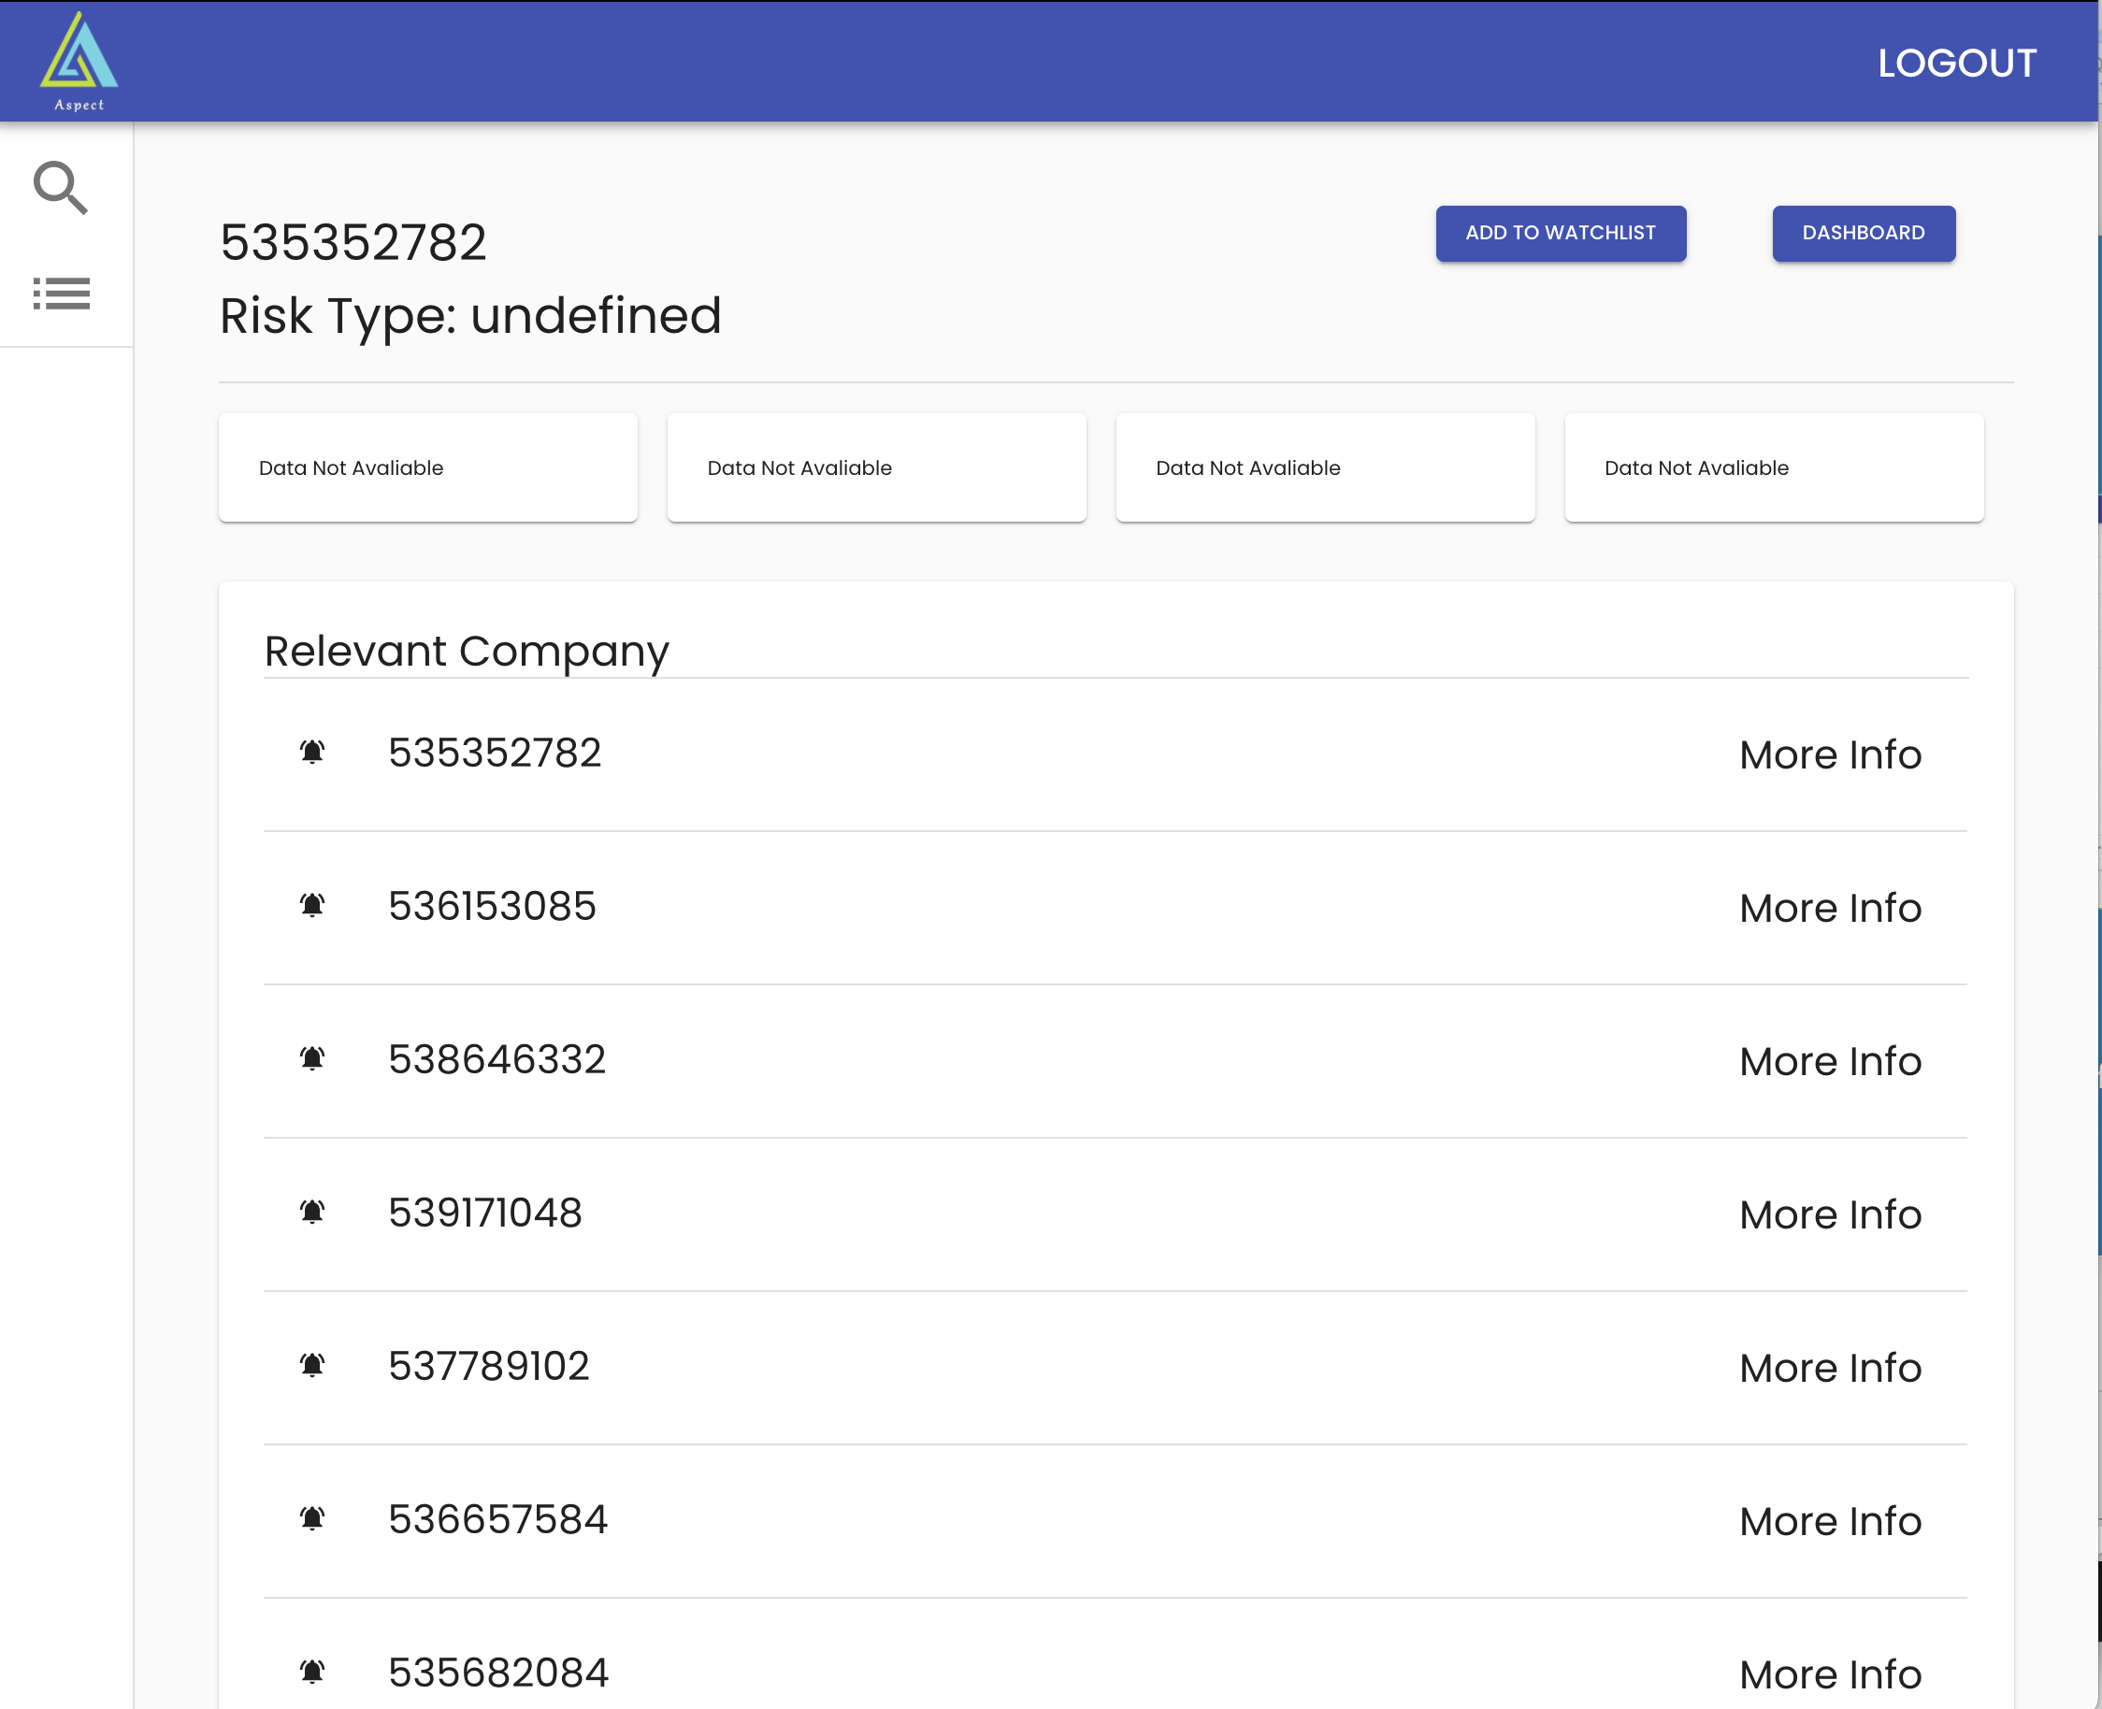
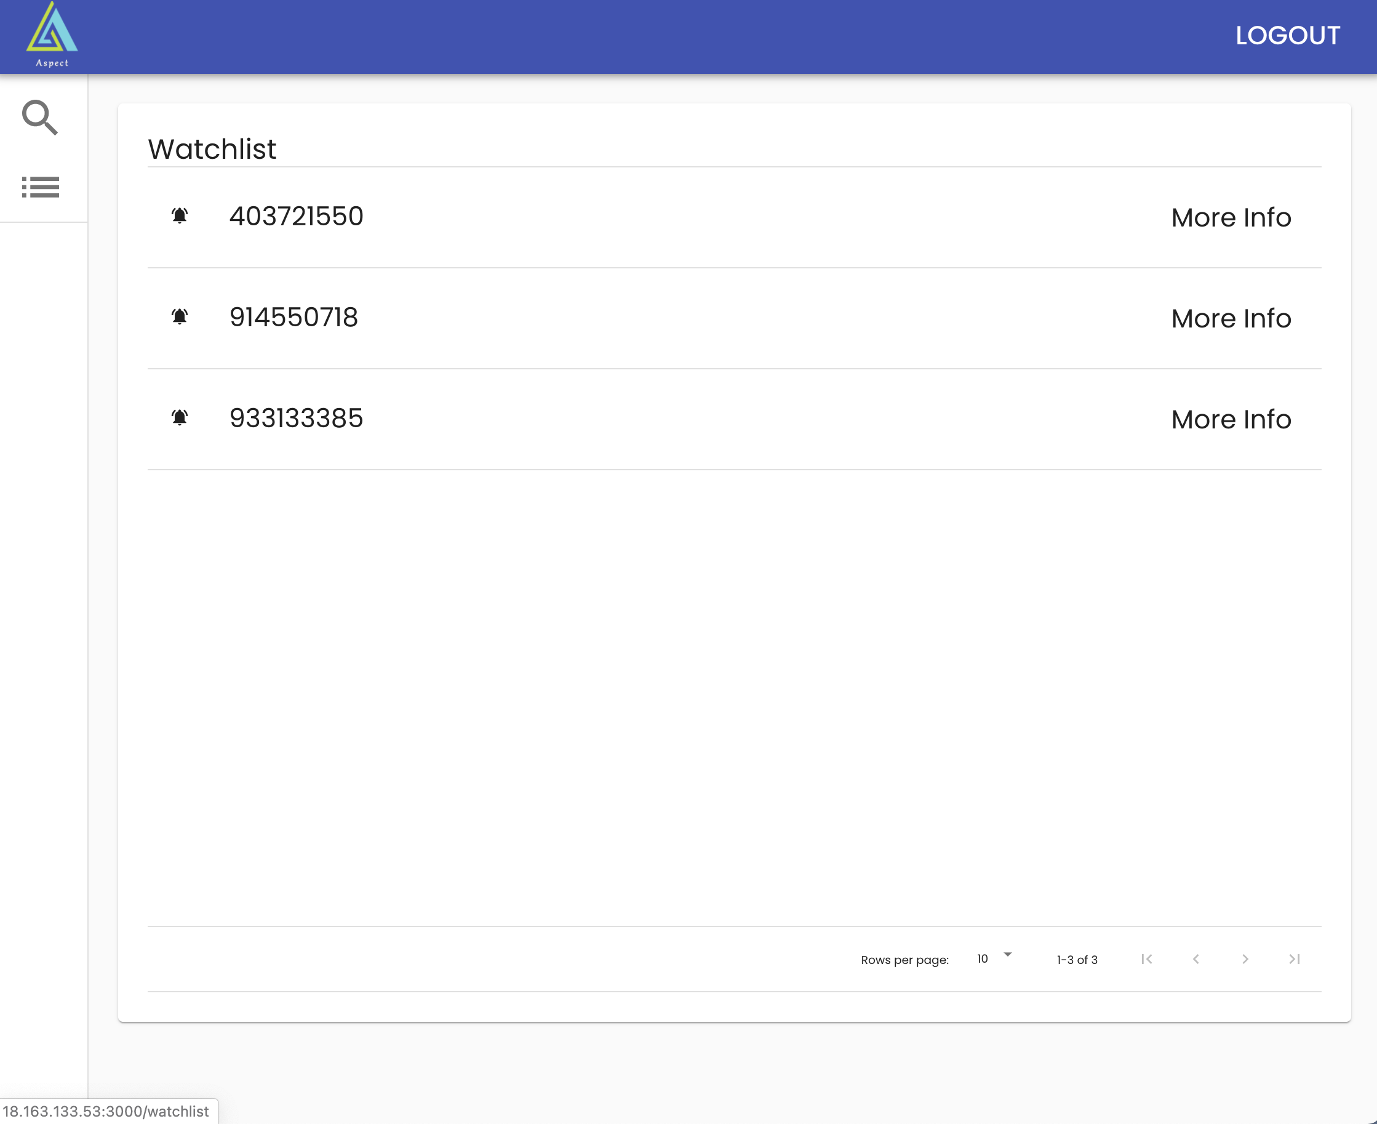
Main Features
Corporate Profile
Risk Analysis
Watch List
to show basic corporate info
to spot potential corporate risks
to save for future ref & alerts

Slide 7

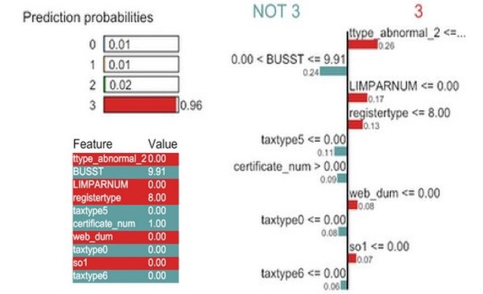
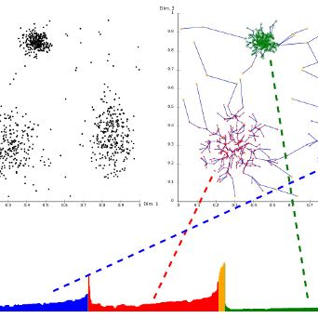
Risk Analysis
Risk Type
by ML (LightGBM)
Risk Explanation
by XAI (LIME)
Relevant Risky Firms
by Clustering (OPTICS)

Slide 8

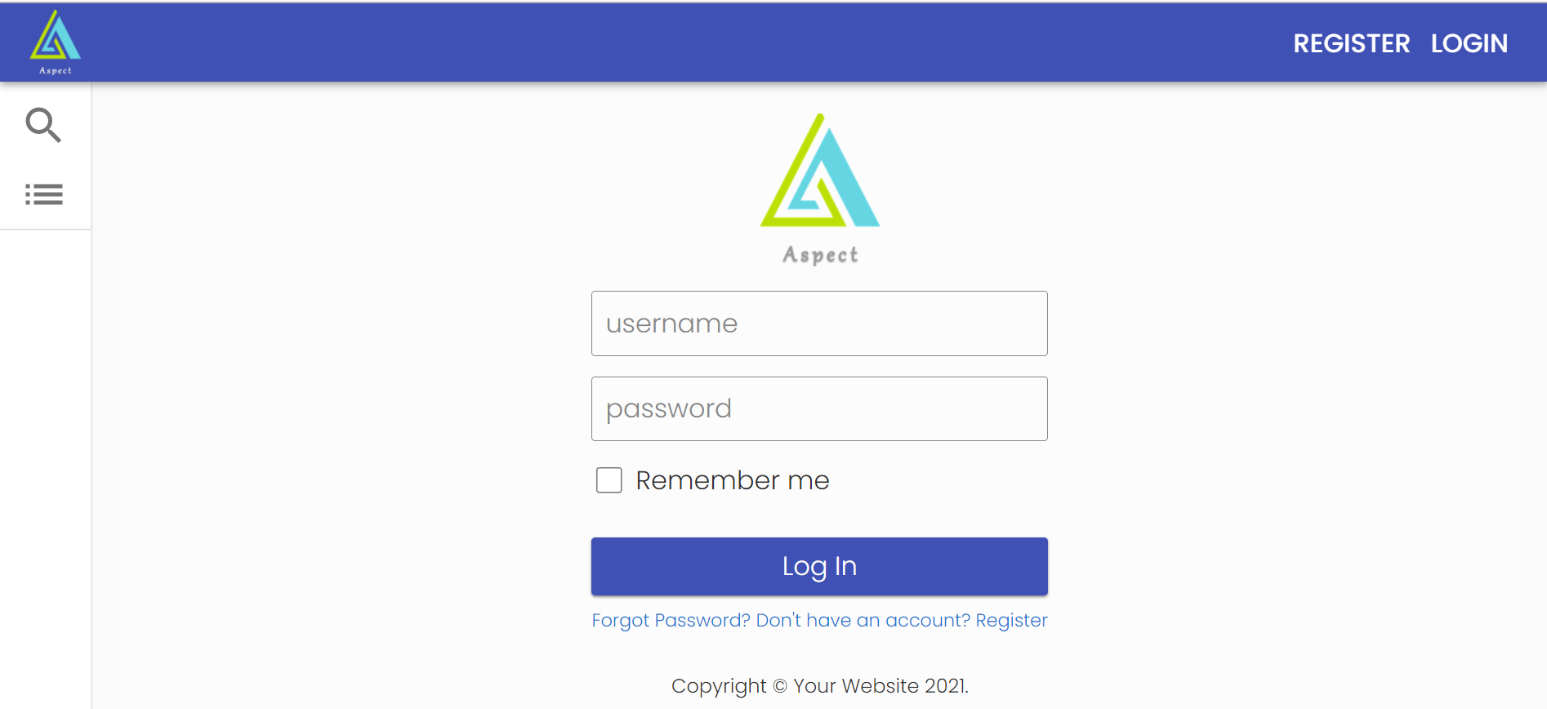
Prototype
Demo

Slide 9



Why Aspect?
Backend
High Performance System Architecture
Frontend
Concise UI
User-Friendly UX
AI
Cutting-edge algo
Reliable Results

Slide 10
Reliable Results
Risk Visualization
Interpretable model
03.
Monetization of data and prediction models &
Transparent evidence of model performance
Easy-understanding of the risk components even for outsiders
01.
Industry-wise Comparison
02.
Concise Evaluation
Targeting the similar firms by unsupervised machine learning
Overall picture of firm’s financial situation &
potential risk level
04.

Slide 11






Winning Cycle
Investors
Concise evaluation of company’s overall picture & potential risk
Efficient to pick the wanted companies by comparison with similar firms
Regulators
AI-accelerated financial surveillance
& risk visualization
Clear to target risk firms and derive due intelligence
Aspect
Managers
Access to industry-wise comparison & explainable risk prediction
Suggestable for internal risk aversion

Slide 12
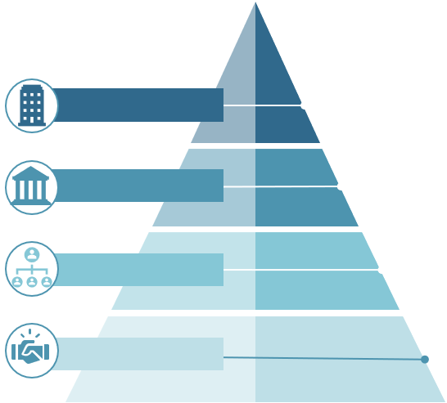


Future Plan
Business Network
Promote sound economic development & connect business with funds!
User Hierarchy
Investors, Regulators & Managers should proceed to different KYC before entering the data pool.
AI Optimization
Explore better AI models with higher accuracy & more efficient response.

Slide 13
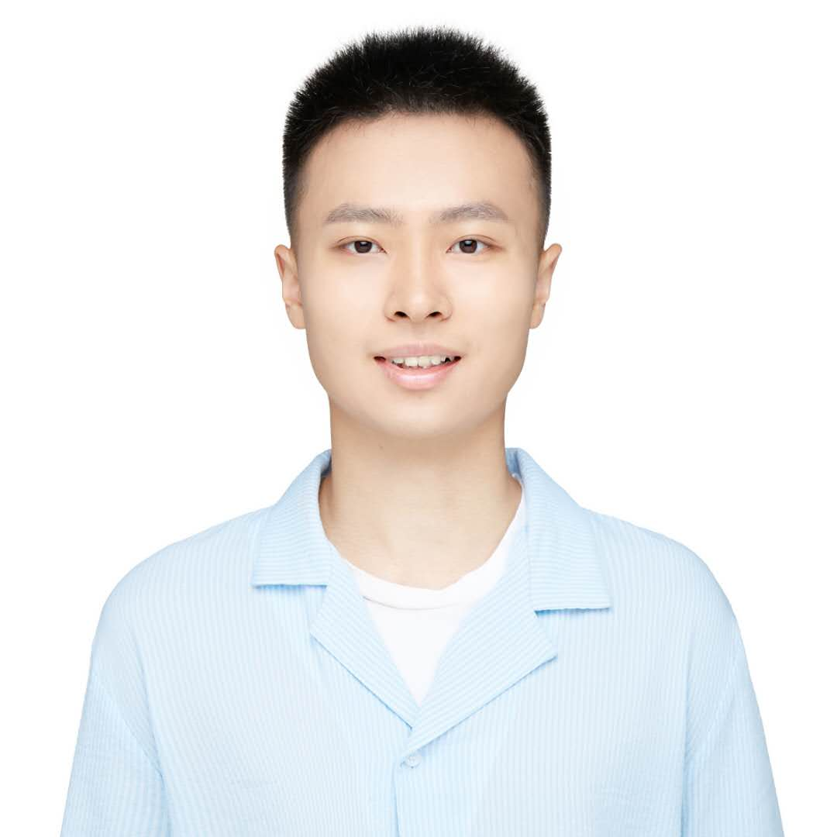
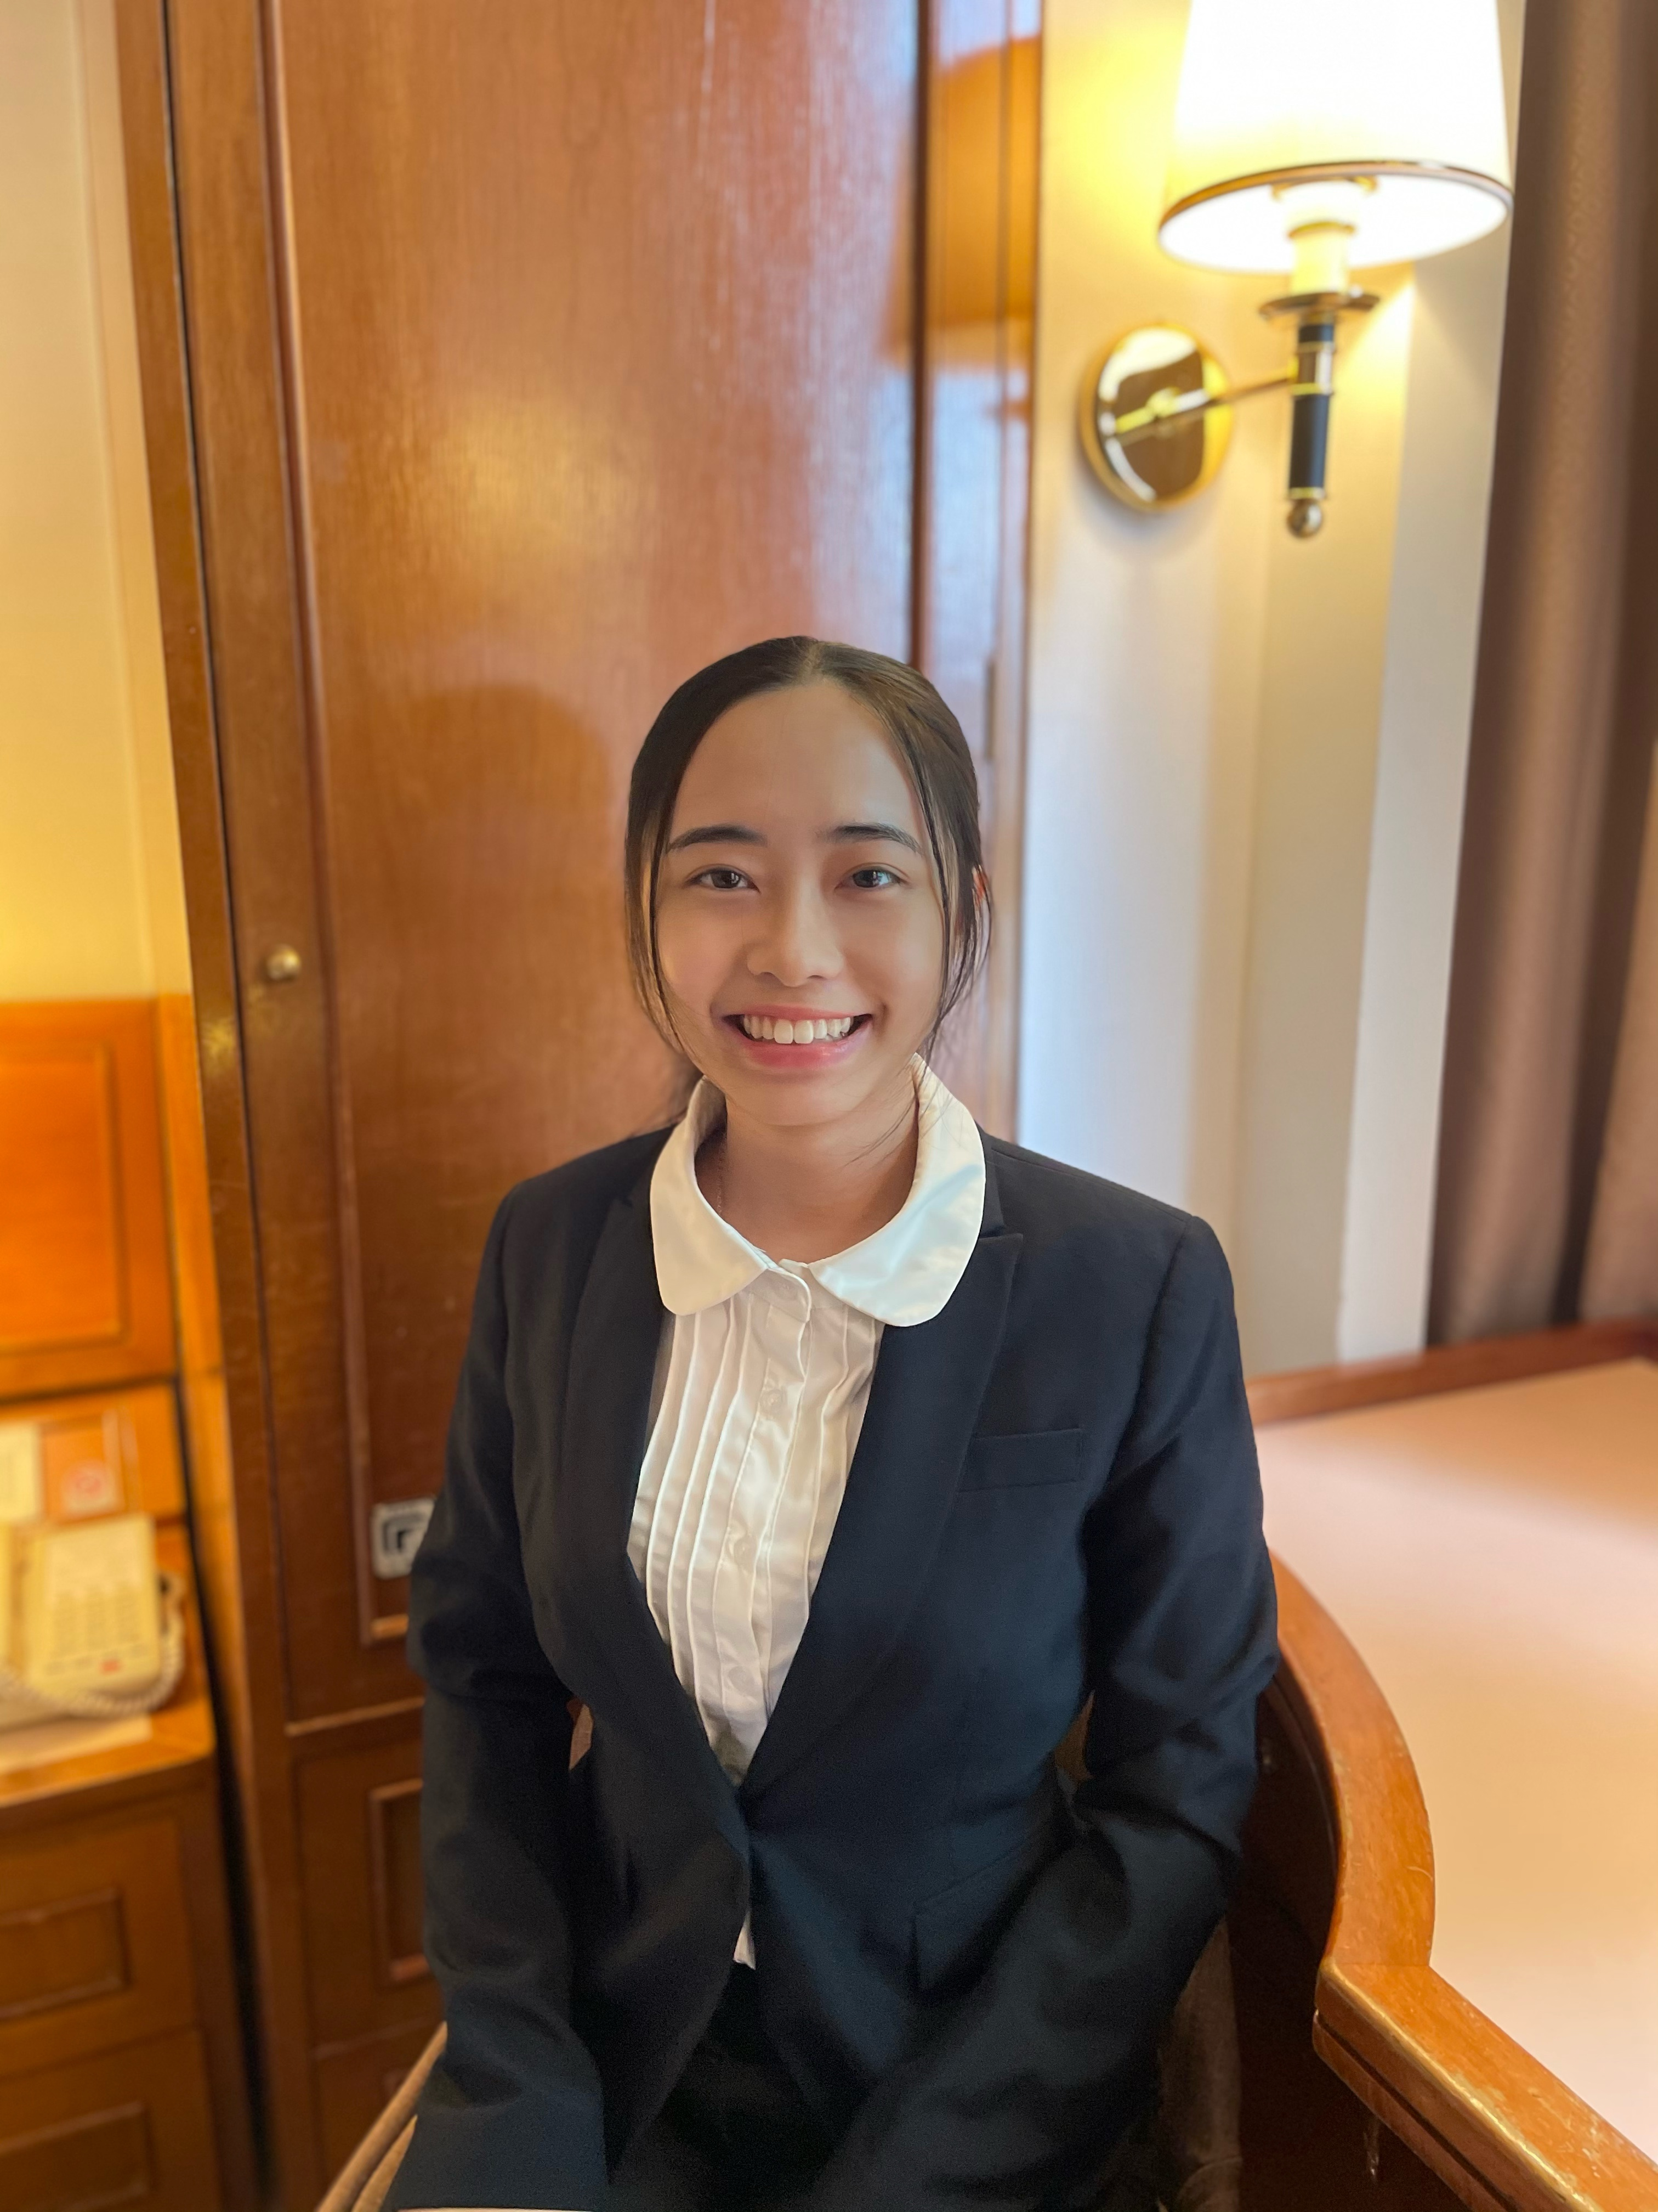
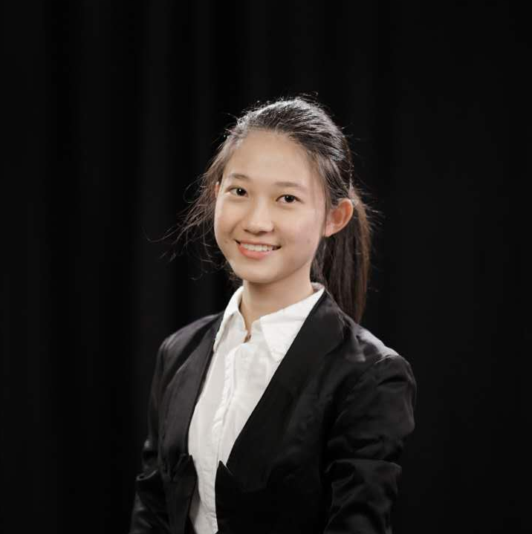

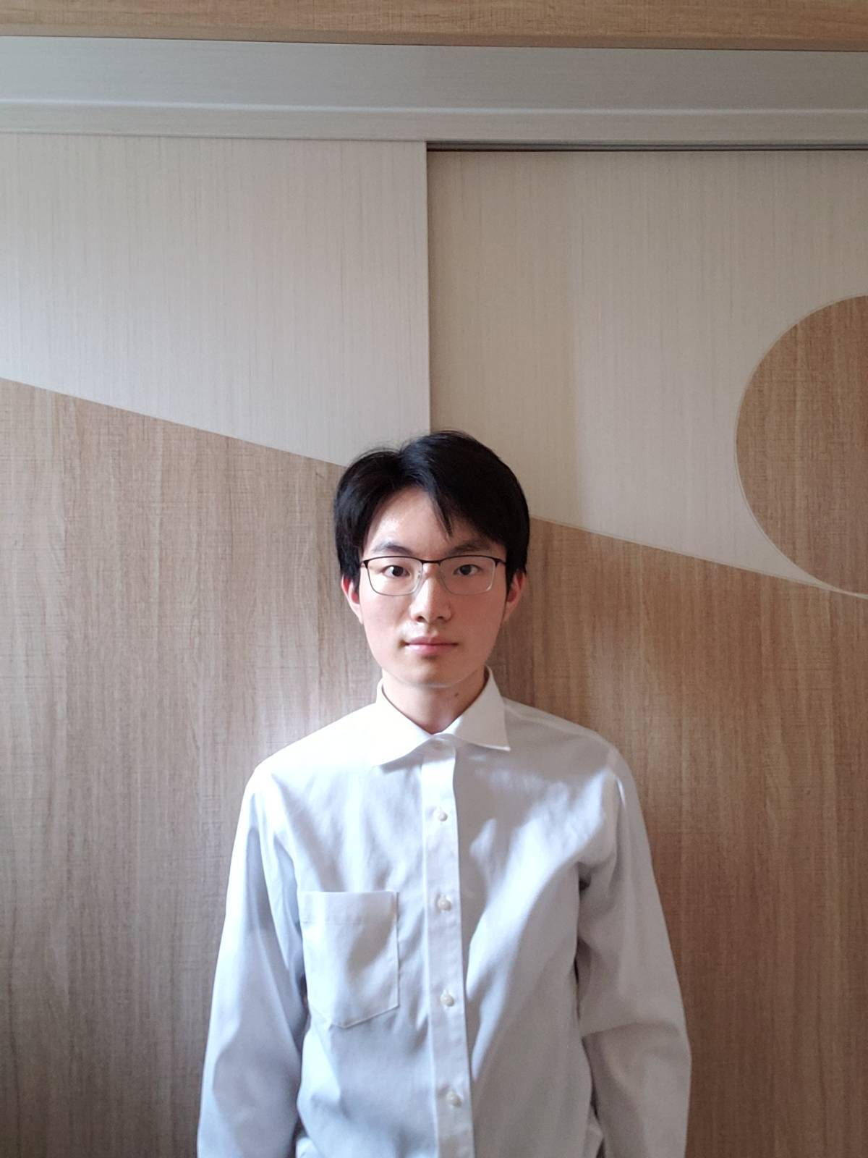
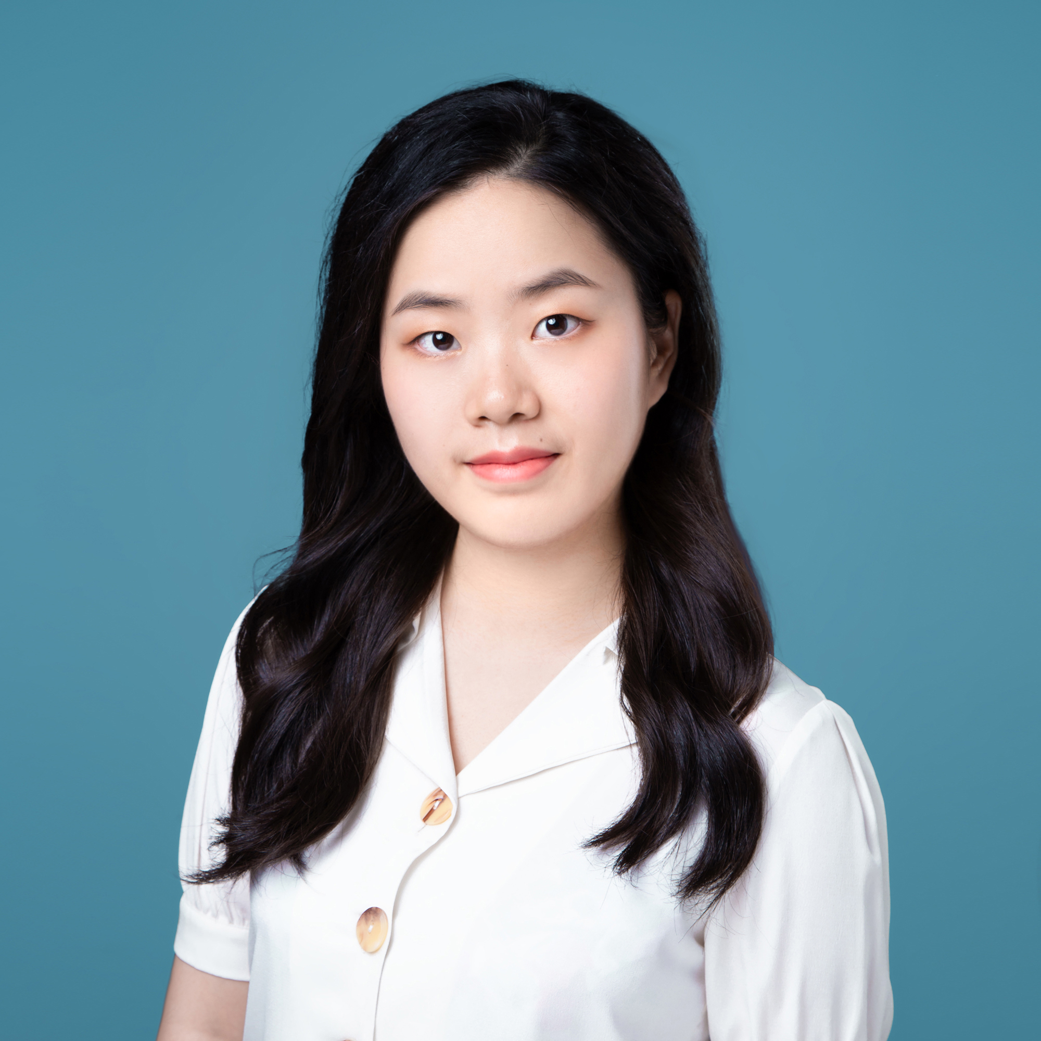
Our Team
Bill Chen
Year 2, FinTech
Hess Lee
Year 2, FinTech
Susan Liao
Year 2, FinTech
Mengling Liu
Master, eCOM&iCOM
Johnny Cheung
Year 2, Computer Science
Rachel Hua
Year 2, Quantitative Finance

Slide 14
Thank You

Slide 15
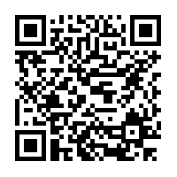

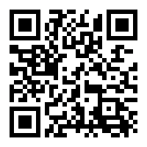

It’s an open source project!
/SWUFE-labs/2021--chengdu80---fintech-contest-hku
Thank You
Visit our GitBook page for detailed documentation!
https://fintechendeavour.gitbook.io/aspect/

